Slide 1
Scenarios
Explain the PBD process
Select appropriate evacuation scenarios
Identify appropriate fire scenarios

Slide 2
Historic Fire
Beverly Hills Supper Club

Slide 3
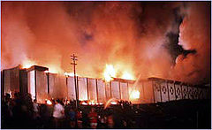
Performance Based Option
Chapter 5 of NFPA101
No rules
Goals and objectives
Some prescriptive rules stay
All stakeholders
Assumptions
Agreement
Establish performance criteria

Slide 4
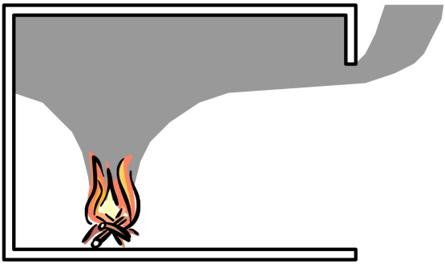

Safety Assessment
Required Safe Escape Time (RSET)
Available Safe Escape Time (ASET)
<
Safe

Slide 5
Occupant Scenarios
Characteristics
Physical
Cognitive
Number
High density
Low density
Location
Activities
Actions
Decisions
Trained staff
Building life cycle
Off-site conditions

Slide 6
Prescribed Occupant Scenarios

Slide 7
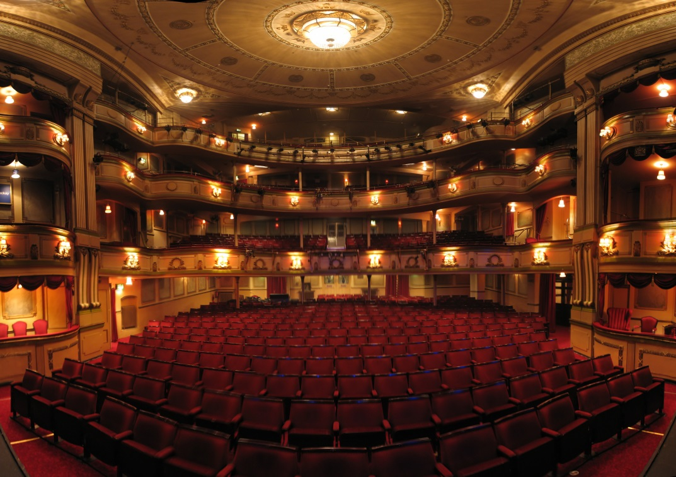
Potential Occupant Scenarios: Characteristics
Sensibility
Reactivity
Mobility
Susceptibility
Normal conditions
Elderly
Children
Disabled

Slide 8
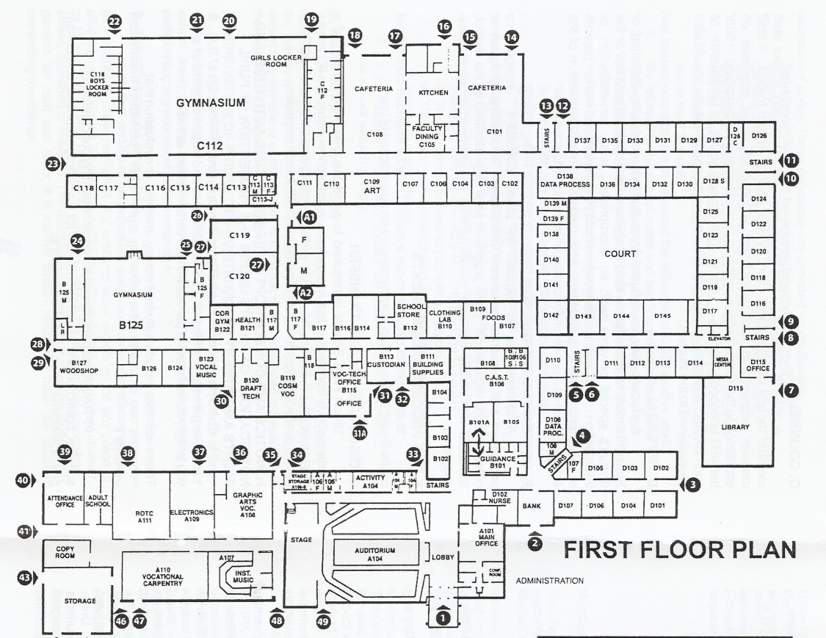
Potential Occupant Scenarios: Number and Location
Normal conditions
Maximum occupant load
All occupied rooms
Average density
Special occasion
Low occupant load

Slide 9
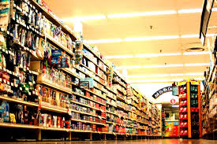
Potential Occupant Scenarios: Activities and Staff
Normal conditions
Delays
Role
Familiarity
Actions
Decisions
Staff assistance
Emergency response personnel

Slide 10
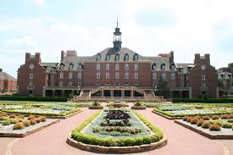
Potential Occupant Scenarios Building and Off-Site Conditions
Post-construction
Off-site

Slide 11
Fire Scenario Considerations
Identify the specific fire safety challenges
Location of the fire
Type of fire
Potential complicating hazards leading to other fire scenarios
Systems and features impacting the fire
Occupant actions impacting the fire

Slide 12
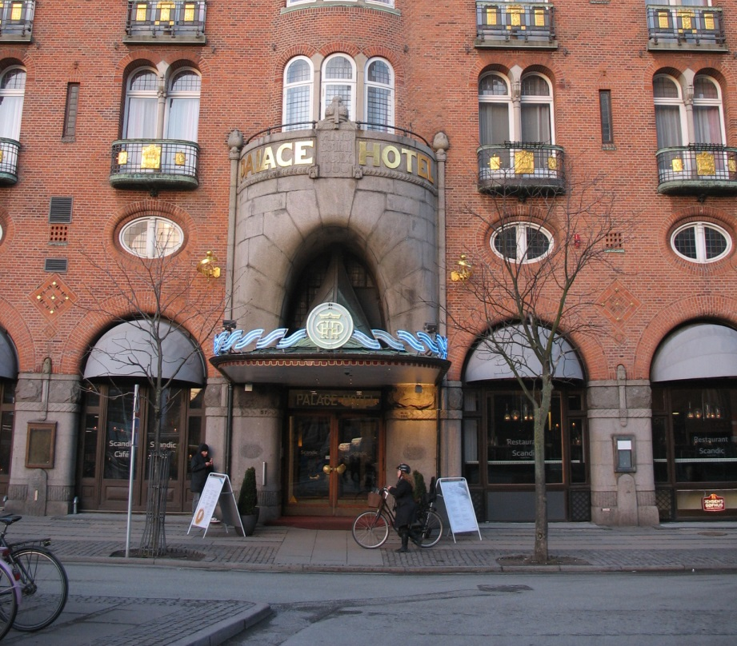

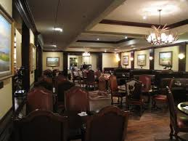

Prescribed Fire Scenarios
Occupancy specific typical fire
Ultrafast fire in primary means of egress

Slide 13


Prescribed Fire Scenarios
Starts in normally unoccupied room with large number of people in another area
Concealed space fire adjacent to a large room

Slide 14
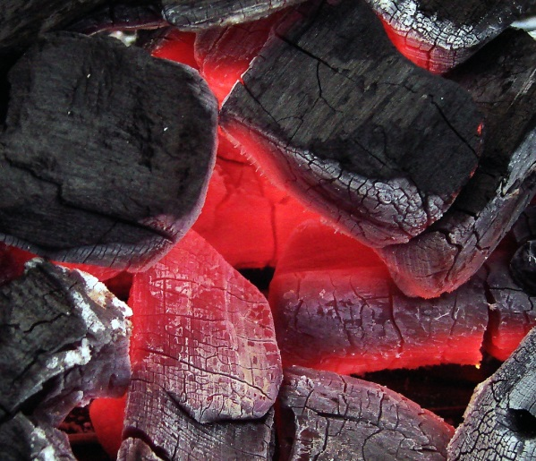
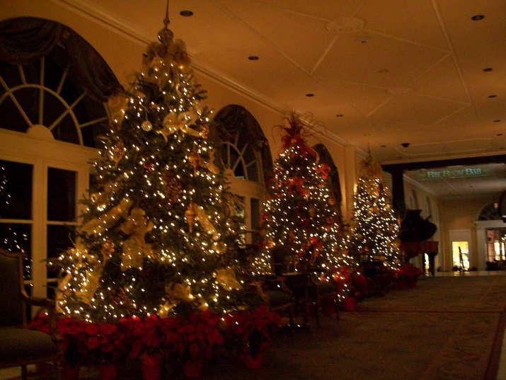
Prescribed Fire Scenarios
Slow fire shielded from systems near high occupancy
Severe fire characteristic of the building

Slide 15


Prescribed Fire Scenarios
Outside exposure fire
Ordinary combustibles fire without passive fire protection system functioning
Ordinary combustibles fire without active fire protection system functioning

Slide 16
Scenario Selection
Must address all potential scenarios
Realistic
Do not have to model all
Results must be documented

Slide 17
Analysis
Deterministic vs. Probabilistic
Sensitivity analysis

